Slide 1
MATH GAME Android Game App
Presented by: Kobi Swisa, Sahar Halili, Roni Milman

Slide 2
Main Activity
Entry point of the app setting up the navigation.
Key Features:
Initializes ‘NavHost’ and ‘NavControoler’.
Defines the start destination and sets up navigation routes.

Slide 3
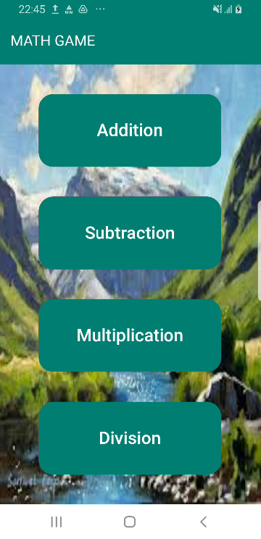
Menu Page
Main menu screen for selecting the game category.
Key Features:
Buttons for different arithmetic operations.
Navigates to the GamePage with the selected category.
Use ‘navController.navigate’ to transition to the GamePage with the selected category.

Slide 4
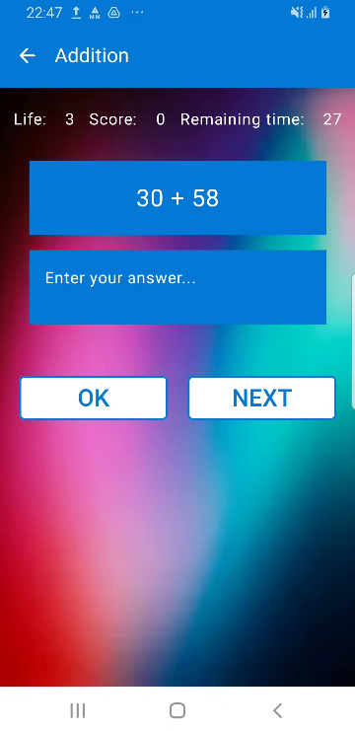
Game Page
Main gameplay screen where users answer math questions.
Key Features:
Displays question, timer, score, and life.
Handles answer submission and navigation to the next question.
State Management: Uses ‘remember’ and ‘mutableStateOf’ to manage game state.
CountDownTimer: Manages the game timer and updates the UI.
Question Generation: Uses ‘generateQuestion’ to create questions based on the category.

Slide 5
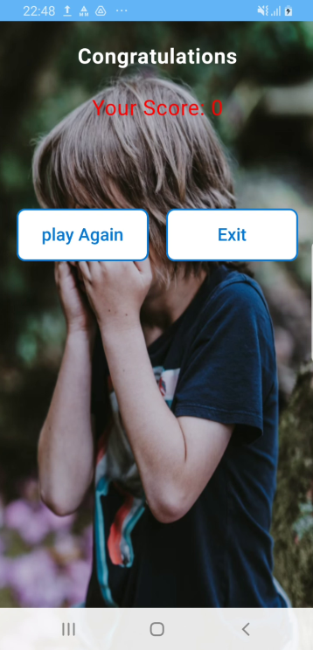
Result Page
Displays the final score and game over message.
Key Features:
Shows the user's score.
Provides options to return to the menu or restart the game.
Navigation Options: Button to navigate back to the main menu.

